Slide 1
Data Structures Workshop
Day 28

Slide 2
Workshop Outline
Final Exam Review
Binary Search Trees
AVL Trees
Graphs
B-Trees

Slide 3
Final Exam Point Distribution
BST → 41 pts.
AVL Trees → 16 pts.
Graphs → 35 pts.
B- Trees → 8 pts.

Slide 4
Binary Search Trees Review

Slide 5
What To Know
ADT Functions
Traversal Methods
Implementation Practice Problems

Slide 6
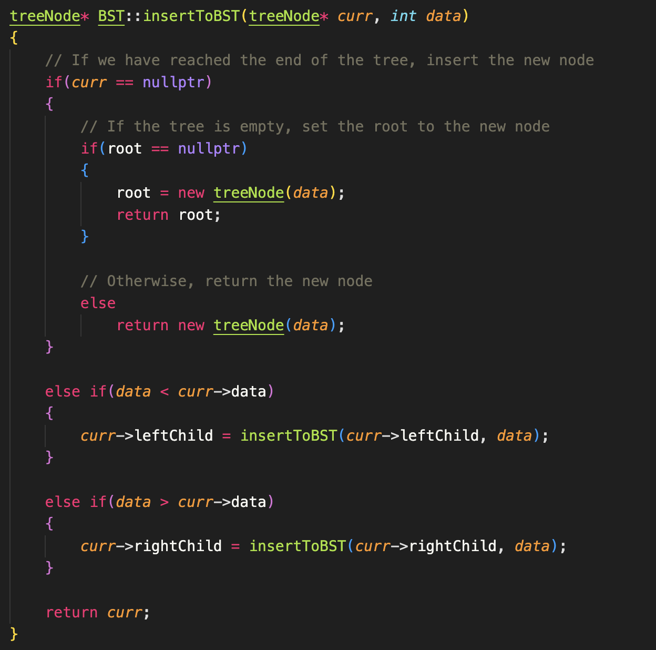
BST Insertion
As we know with BST insertion, the idea is as follows:
If no values are present in BST, the value we’re inserting will become the root
If other values are present, check whether the value is less than or greater than the root node. If less, go left, if greater, go right
Traverse through BST until you find correct place to insert to

Slide 7
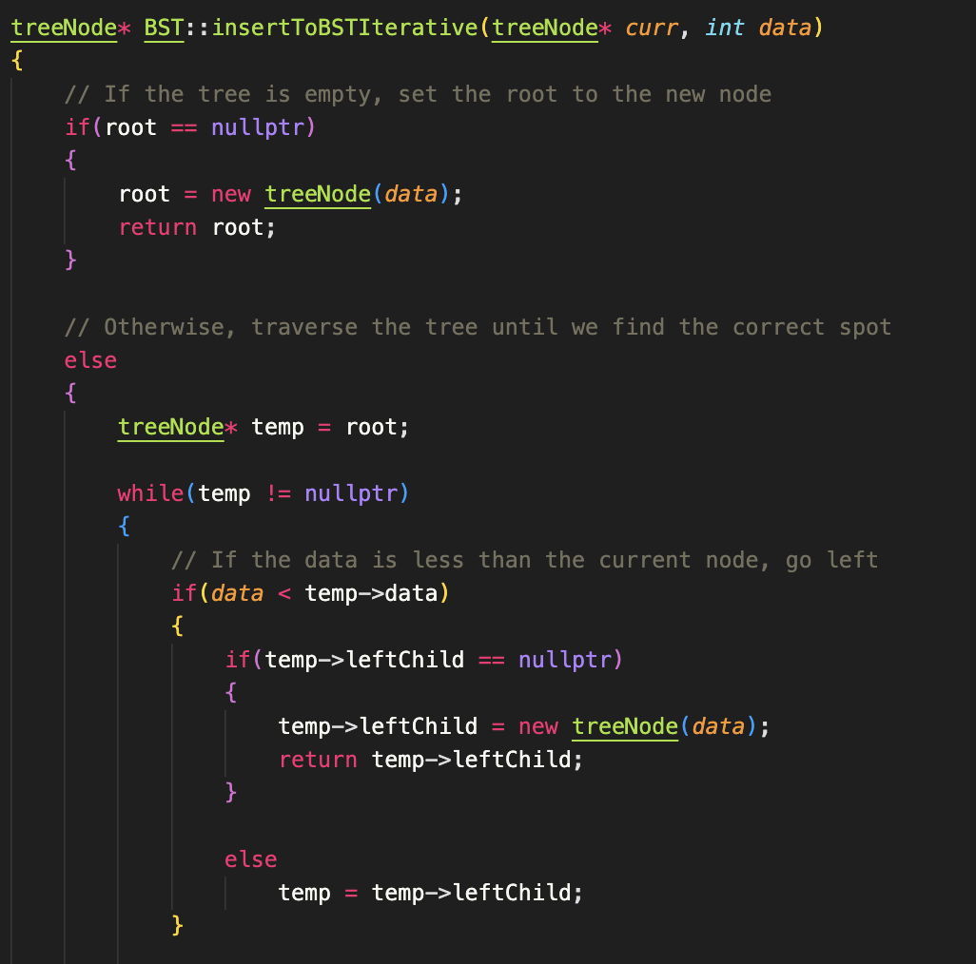
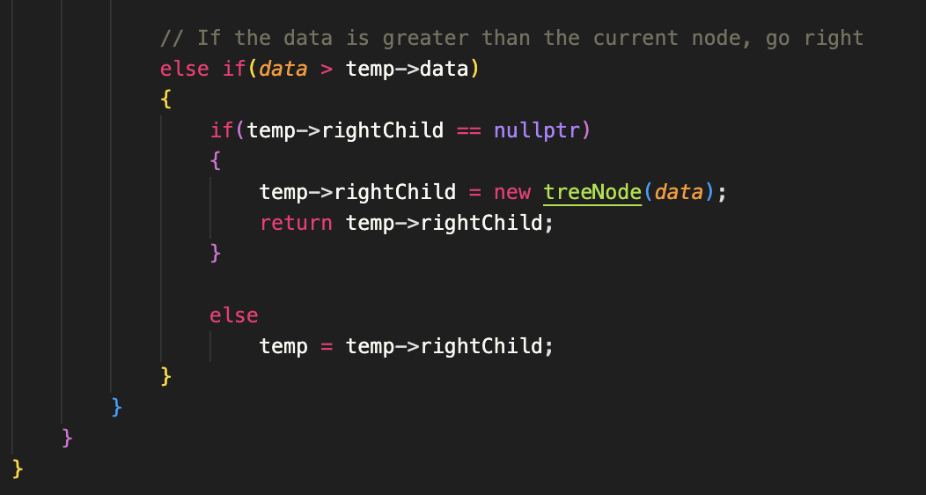
Iterative Method

Slide 8
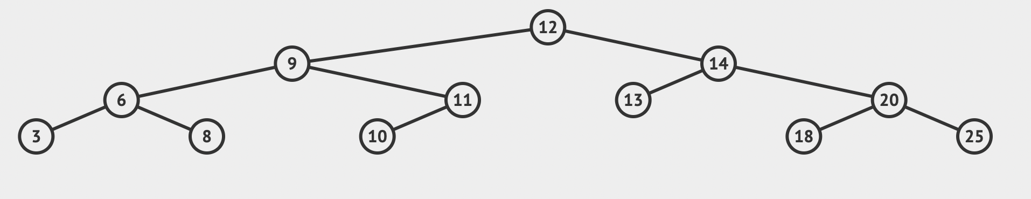
Traversal Types
Preorder:
Inorder:
Postorder:
12, 9, 6, 3, 8, 11, 10, 14, 13, 20, 18, 25
3, 6, 8, 9, 10, 11, 12, 13, 14, 18, 20, 25
3, 8, 6, 10, 11, 9, 13, 18, 25, 20, 14, 12

Slide 9
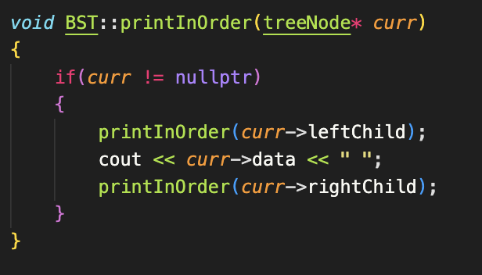
Traversal Code
What changes in Preorder and Postorder traversal implementation?

Slide 10
Inorder Successor/Predecessor
Inorder Successor of 9: 10
Inorder Predecessor of 9: 8
Inorder Successor of 11: 12

Slide 11
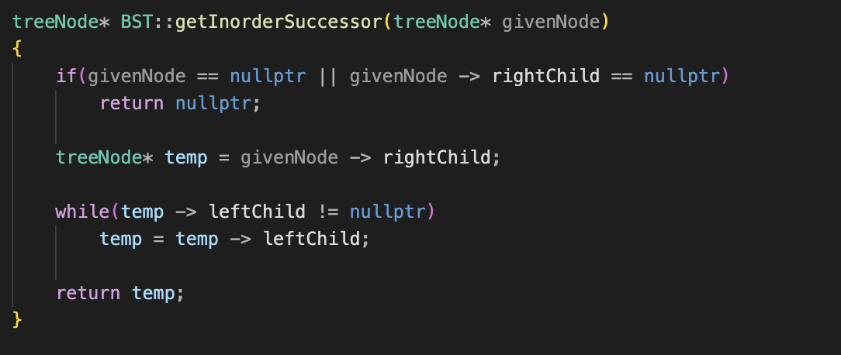
Implementation

Slide 12
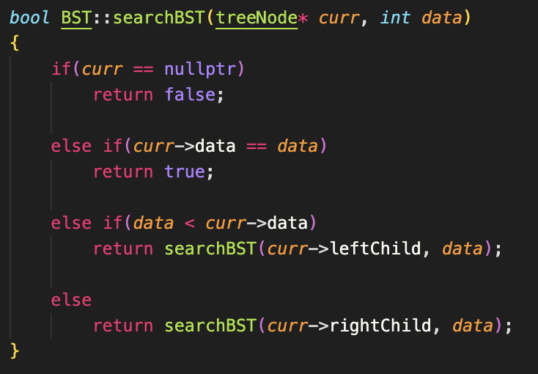
Does a value exist in our BST?
Implement a function that checks whether a value exists in our BST.

Slide 13
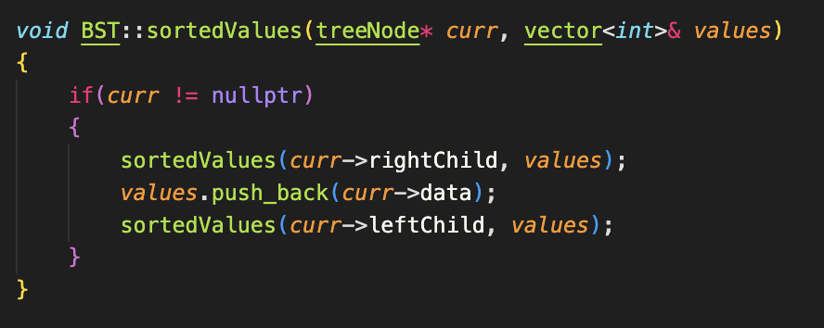
sortedValues()
Implement a function that adds the values in a BST into an array in descending order. sortedValues(node* root, vector<int> &arr).

Slide 14
AVL Trees Review

Slide 15
What To Know
Rotations (Code and Tracing)
Inorder Successor/Predecessors
More AVL ADT Exclusives
Know how to insert values into an AVL Tree (w/ rebalancing)

Slide 16
AVL Insertion Practice
Insert the following values into an AVL tree, show the tree after every insertion:
[21, 17, 15, 19, 18, 10, 8, 13]

Slide 17
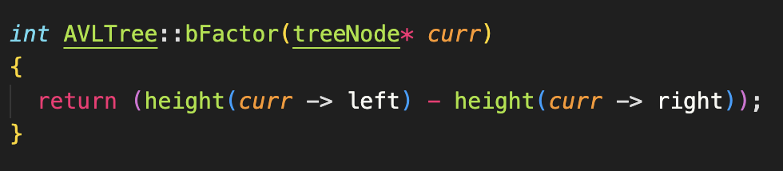
balanceFactor()
Implement a function that returns the balanceFactor(node *givenNode) of a given node.

Slide 18
Graphs Review

Slide 19
What To Know
Adjacency Matrices/Lists
BFS and DFS Algorithm
Minimum Spanning Tree Algorithms
Prim’s & Kruskal’s
Dijkstra’s Algorithm

Slide 20
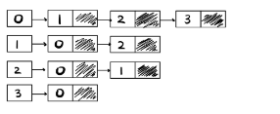
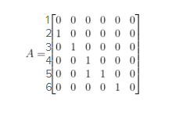
Graph Representations
An adjacency list represents a graph as an array of linked lists.
Index is the vertex and each element in the list is other vertices that form an edge with the index.
An adjacency matrix is a way to represent a graph as a matrix of Boolean values (0’s and 1’).
Rows represent the vertices of a graph and the columns represent the edges

Slide 21
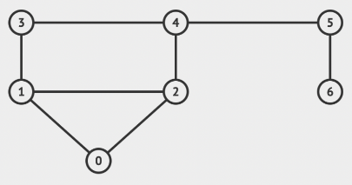
Adjacency Matrix vs Adjacency List
Given the graph, write out its representation as an adjacency matrix and adjacency list.

Slide 22
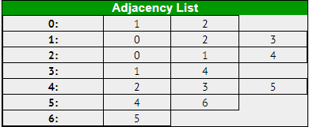
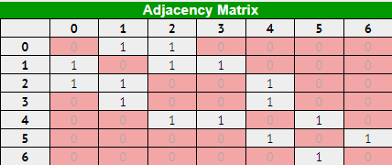
Solution

Slide 23
Depth-First-Search (DFS)
Breadth-First-Search (BFS)
The DFS algorithm uses a STACK and works in the following way:
1. Start by pushing a source vertex to the top of the stack.
2. Take the top item in the stack and add to visited list.
3. Make a list on that vertices adjacent nodes (unvisited). Add the nodes that aren’t in the visited list to the top of the stack.
4. Keep repeating steps 2 and 3 until stack is empty.
The BFS algorithm uses a QUEUE in the following manner:
1. Start by putting any source vertex in the queue
2. Take front item of queue and add to visited list
3. Create list of that vertices adjacent node. Add the ones which aren’t in the visited list to the back of the queue.
4. Repeat steps 2 and 3 until queue is empty.

Slide 24
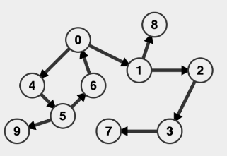
BFS & DFS Practice
Perform the DFS & BFS algorithm on the following graph and show the order in which the nodes were visited (assuming 0 is the source node)

Slide 25
BFS Implementation
Implement the BFS(int graph[][], int sourceNode, int numVertices) algorithm represented as an adjacency matrix. It should as well print the order in which the vertices are visited.

Slide 26
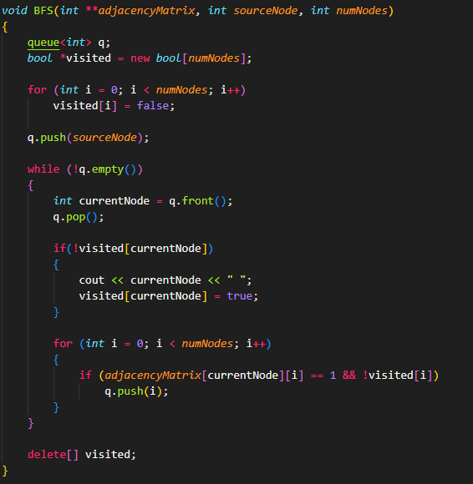
Implementation

Slide 27
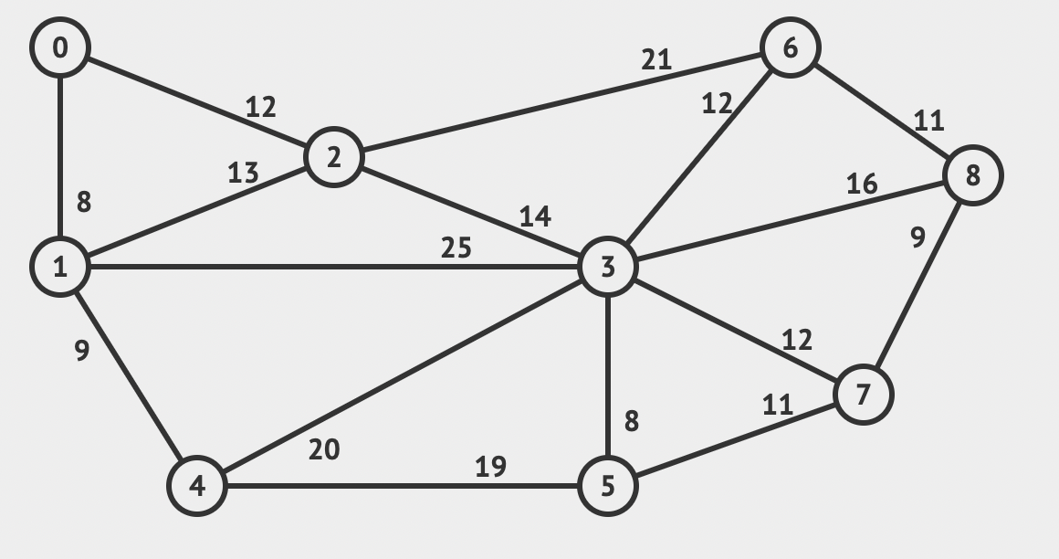
Prim’s Algorithm
Perform Prim’s Algorithm on the following graph and draw the minimum spanning tree. Start from Vertex 5.

Slide 28
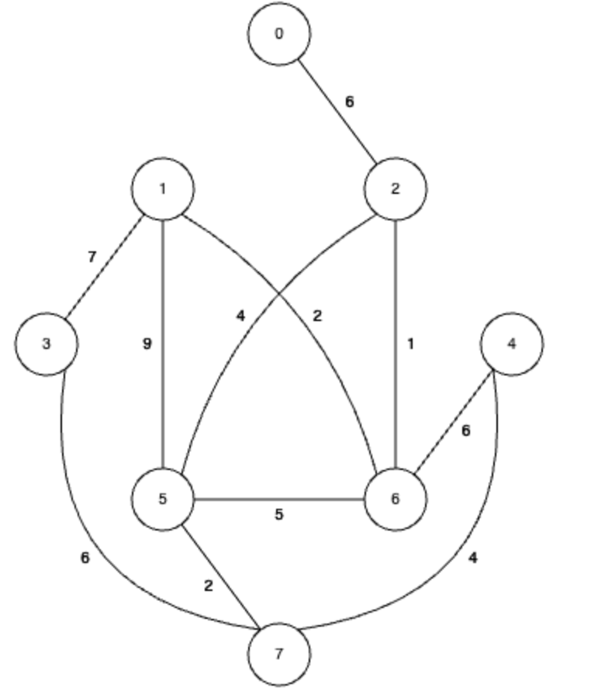
Kruskal’s Algorithm
Perform Kruskal’s Algorithm on the following graph and draw the minimum spanning tree.

Slide 29
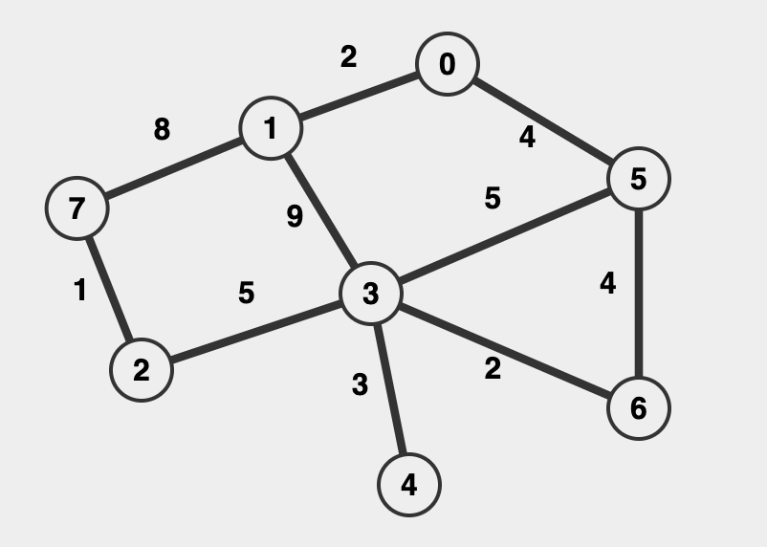
Dijkstra’s Algorithm
Given the graph, draw the shortest path tree using Dijkstra’s Algorithm starting from Vertex 1.

Slide 30
B-Trees Review

Slide 31
B-Tree Insertion
Traverse from the root down to a leaf node (make sure you traverse and maintain the order of values within each node)
Once you reach a leaf node, insert into the correct position
If the node already has n (degree - 1) values, or is full:
Split the node in half
Take the middle node and move it up as the parent
If there is even number of values, take either left middle or right middle, just be consistent
Values on the left of the middle are now the left children on that value, and values on the right are now the right children

Slide 32
Practice
With a degree of 3, build a B tree using these values:​
8, 9, 10, 11, 15, 20, 17​

Slide 33
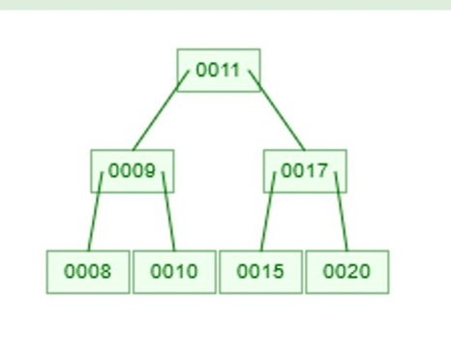
Solution

